Slide 1
Connected Devices Raspberry Pi – Rotation 1
David Crook
@Data4Bots
Questions: dacrook@Microsoft.com

Slide 2
Agenda
The ‘me’ slide
Things to know
Goals
Content
Summary
Continuous Q&A

Slide 3
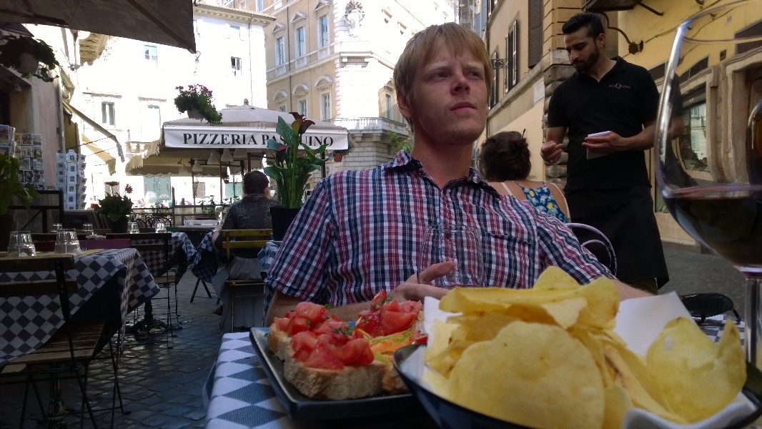
David Crook
Microsoft Developer Evangelist
Focused on Machine Learning and Embedded Systems
Enjoys challenges
Likes Fishing + Brazilian Jiu Jitsu
Typically not together
dacrook@Microsoft.com
(980)228-6278
@Data4Bots
www.indiedevspot.com

Slide 4
Stuff you should Know About
Additional Resources
Channel9: http://channel9.msdn.com
Hackster: https://www.hackster.io
Stack Overflow: http://electronics.stackexchange.com/
BizSpark
Free Azure
Free Tools Network Partner Give to your startups for free
Microsoft Innovation Center
Hack Tuesdays: Mentoring every Tuesday 11am – 2pm
Free Co-Working for Startups: dacrook@Microsoft.com to apply
Free Training: See schedule here: http://indiedevspot.com/events/

Slide 5
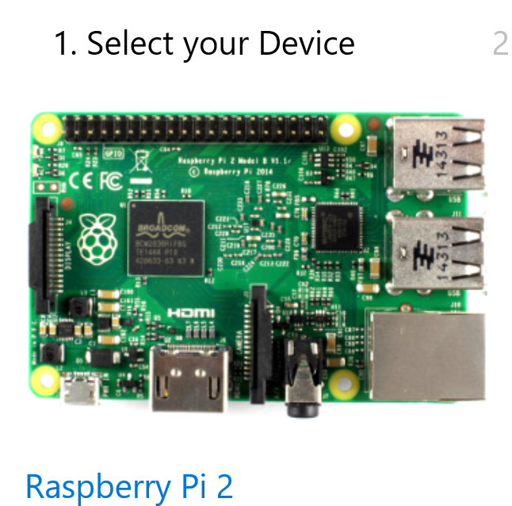
Future Reference Getting Started
http://ms-iot.github.io/content/en-US/GetStarted.htm

Slide 6
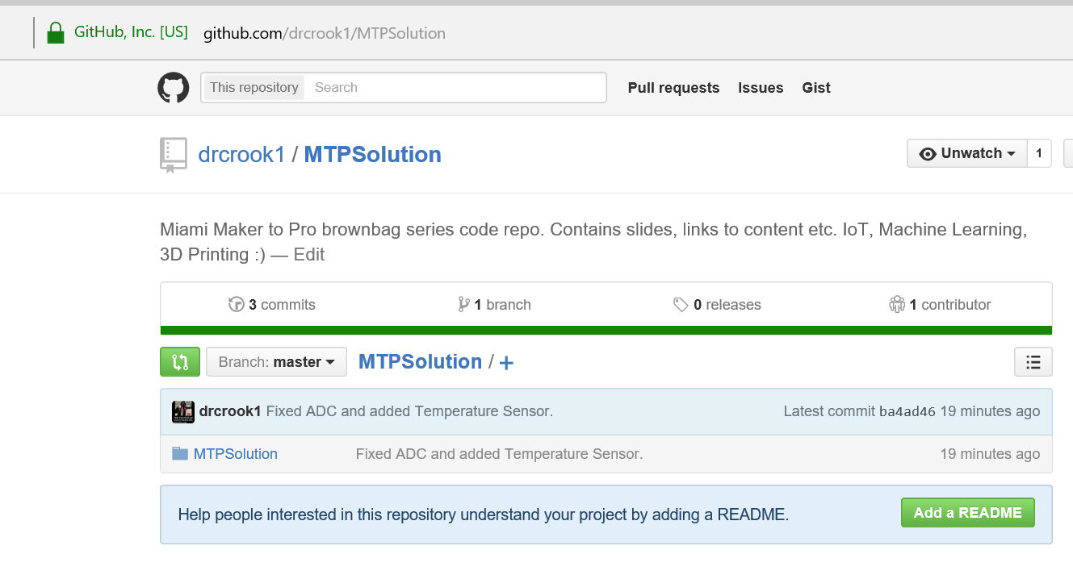
Get the Codes
https://github.com/drcrook1/MTPSolution

Slide 7
Goals of Presentation
Define IoT
Define how Azure facilitates IoT
SQL Azure
IoT Hub and Stream Analytics
Visualizing Data in a Website

Slide 8
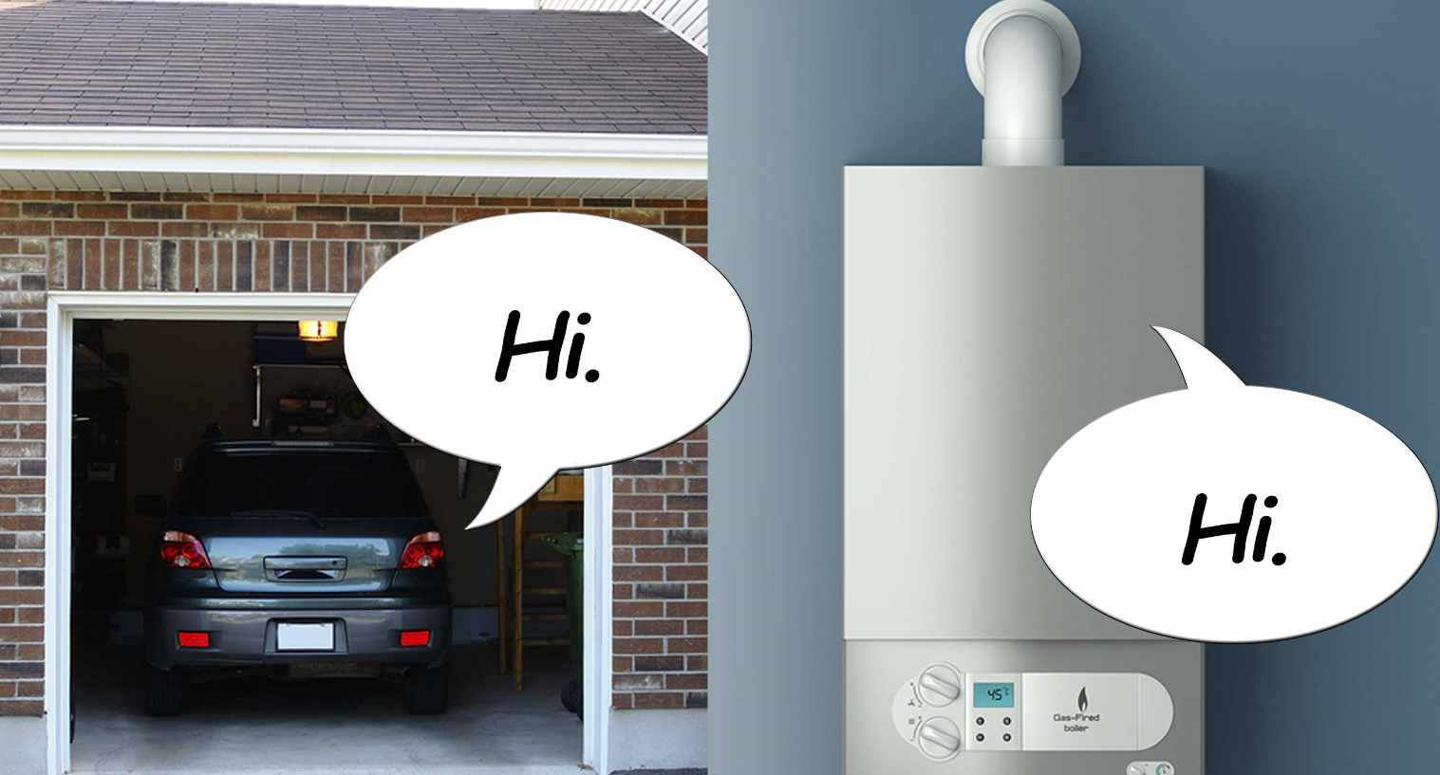
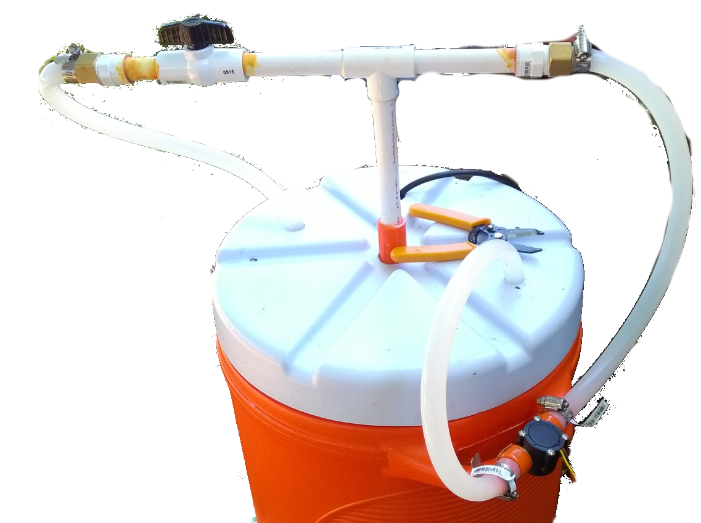
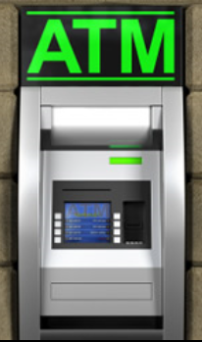
What is IoT?
Things
Connectivity
Data
Advanced Decisions
Intelligent Devices
Notes:
Differentiating factor from just internet connected devices is the paradigm that you collect data and push intelligence to IoT devices.

Slide 9

Example Use Cases
Vibration from Sensors
Data from on-board computers (e.g. cars)
Predictive Maintenance
Find Failures before they happen. Estimate useful
life of equipment
Process Optimization
Business and Manufacturing Processes
Product Optimization
Better understand products for future improvements
Increase Marketing Capabilities
Understand how products are used, where and market appropriately.
Acoustic data from Engines
Engine Telemetry Data (temperature, humidity, pressure, altitude)
Measures from factory floor

Slide 10
Why now?
Cheap Resources
Computers and storage are cheaper than they have ever been and continue to reduce in cost.
Efficient Tools
Modern tools to accomplish complex tasks are very efficient and effective
Connected Infrastructure
Constant connectivity is not a problem and is becoming much cheaper.
Human Skills
More people know how to program now than ever.
Documentation
Between online searches, vendor documentation and training websites

Slide 11
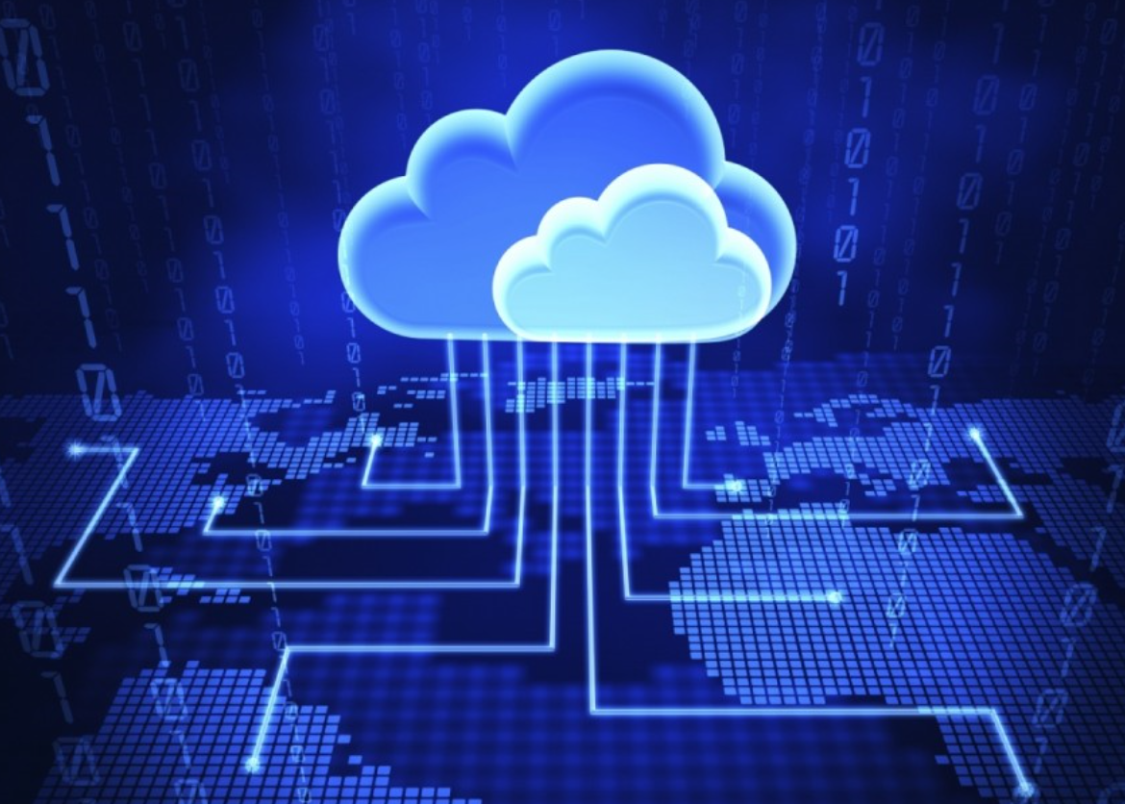
Azure + IoT
Azure = Microsoft Cloud Platform
Message Passing
Databases
Analytics Clusters
Servers
Machine Learning
Load Balancing
Websites
Notes:
PaaS vs IaaS vs SaaS
-> Focus on PaaS

Slide 12
The Opportunity
IDC Estimates $7.1 trillion
Others estimate between $5 and $20 trillion.
Notes:
International Data Corporation
So of course Microsoft is interested in an IT pie valued in excess of $7 trillion.

Slide 13

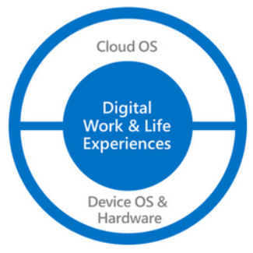
Developer Tools
Visual Studio, TFS, C#, Windows, the list goes on.
Software Services
Client Services
Cloud Services
Infrastructure Services
Products
Holistic View
Focus on end to end customer needs
Focus on the full spectrum of requirements
Focus on delivering value in all areas
Notes:
Partnerships,
Elevating Consulting firms with needed skills at appropriate price points,

Slide 14
Hands on Lab

Slide 15
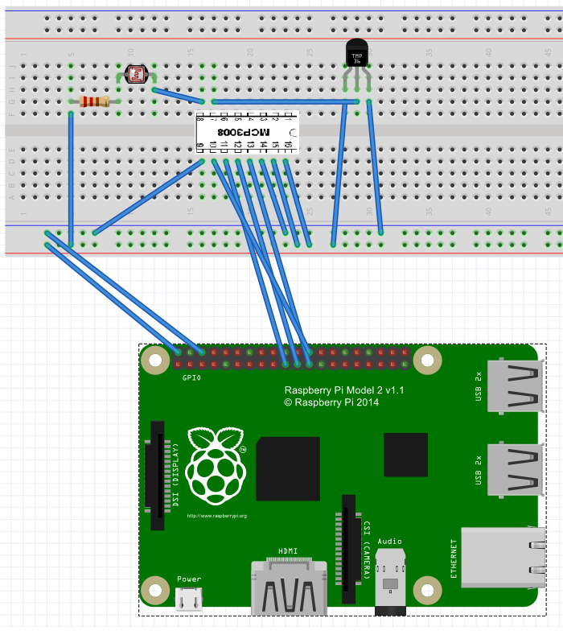
Initial Wiring
Sike!
From previous lab
Intended use case

Slide 16
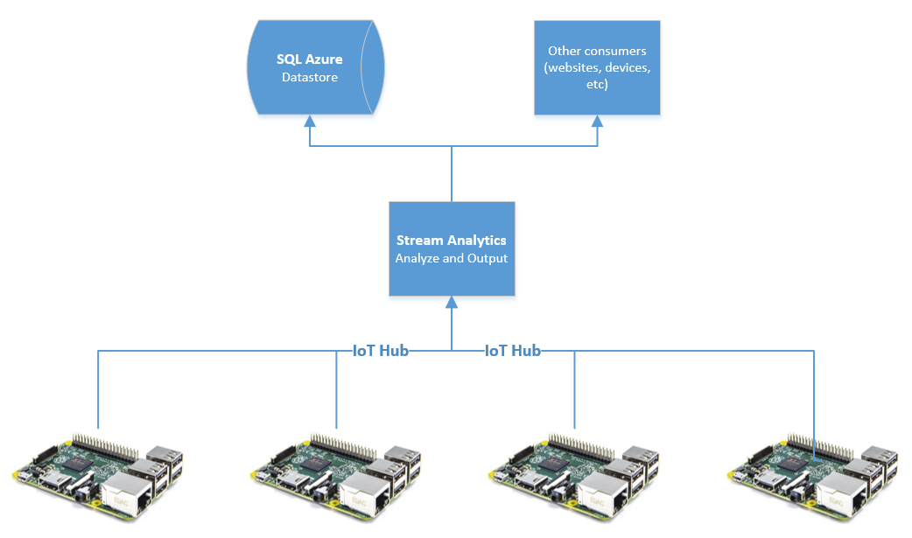
SQL Azure, Stream Analytics and IoT Hub
Place to store data
Analyze live data
Way to ingest data
Notes:
During this time ensure everybody logs into Azure

Slide 17
Walk through – Azure Portal
Basic Walk around
Old portal
New portal
Provision SQL Server
Provision IoT Hub
Provision Stream Analytics

Slide 18
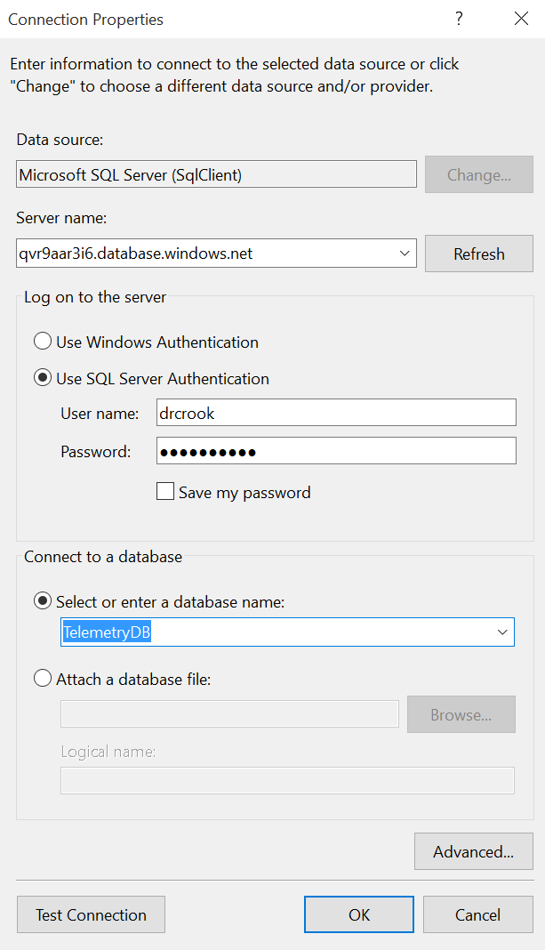
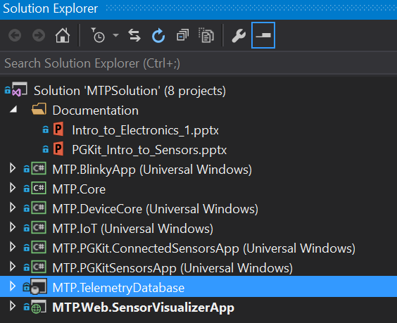
Deploy SQL Server Schema
https://channel9.msdn.com/Blogs/Have-you-tried-turning-it-off-and-on-again/Deploying-Database-Projects-to-SQL-Azure
Right Click DB Project - Publish
Notes:
Make sure to show where to get these settings from in the Azure portal.
Use the channel9 video for reference if needed.
https://channel9.msdn.com/Blogs/Have-you-tried-turning-it-off-and-on-again/Deploying-Database-Projects-to-SQL-Azure

Slide 19
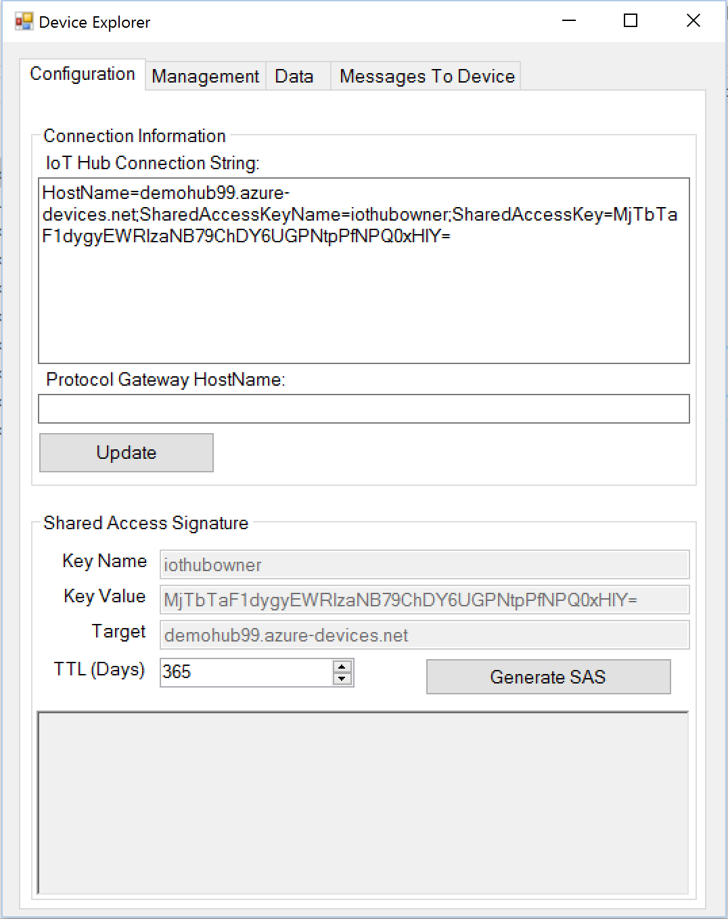
Install Device Monitor
https://github.com/Azure/azure-iot-sdks/releases/download/v1.0.0-preview.4/SetupDeviceExplorer.msi
C:\Program Files (x86)\Microsoft\DeviceExplorer
Notes:
To get IoT Hub connection string, you must be on the new portal

Slide 20
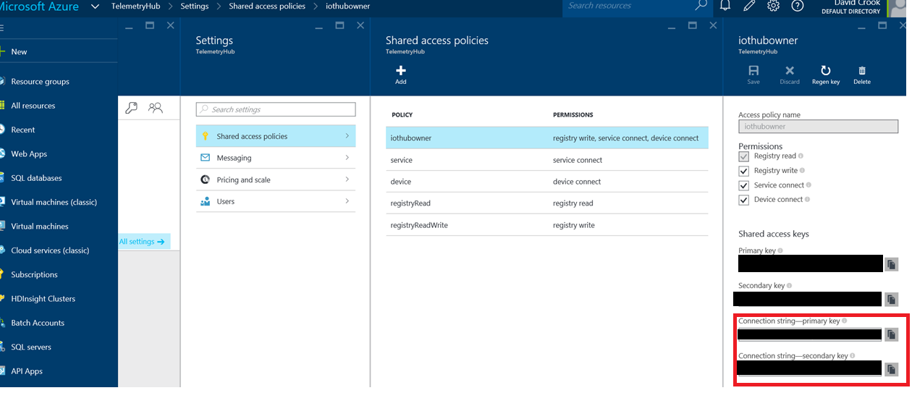
Get IoT Hub Connection String

Slide 21
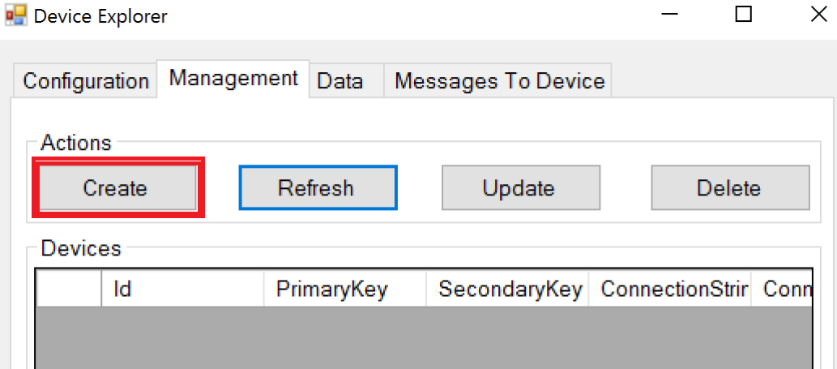
Manage Devices – Create New Device
Notes:
From the Device Explorer.

Slide 22
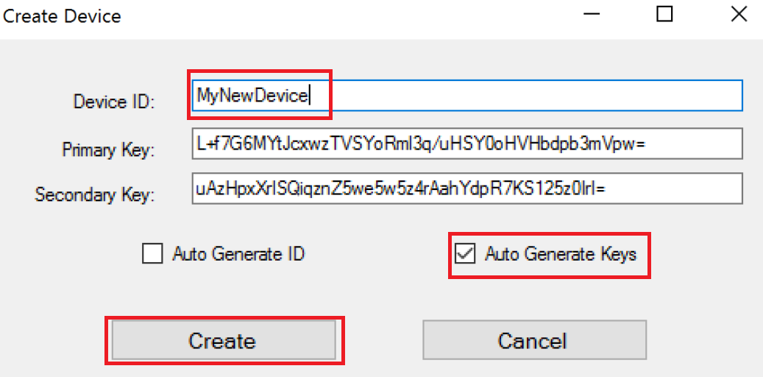
Provision and register a device
Notes:
Take note of DeviceId, you will use this later.

Slide 23
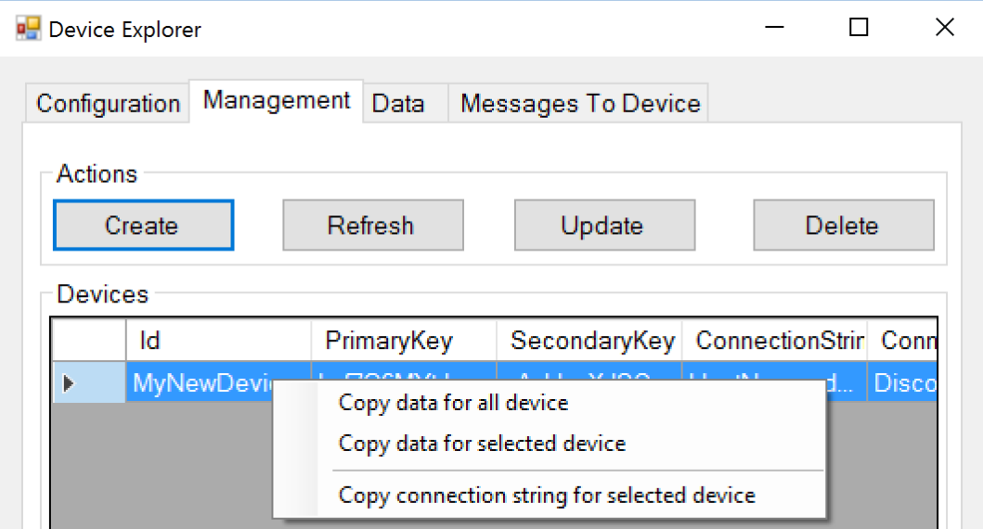
Get Device Connection String
Click on Device
Get Context
Select Copy Connection String

Slide 24
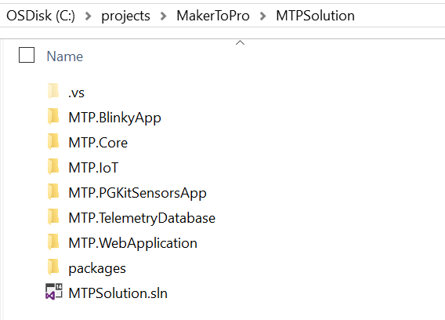
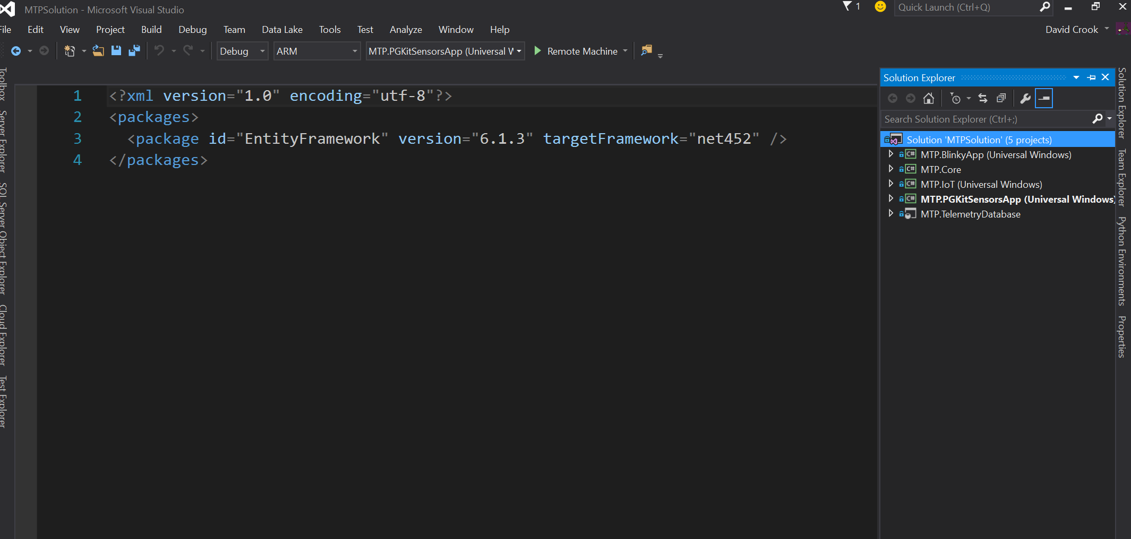
Open the Code
Open Visual Studio 2015 Community
Excellent programming tool.
Double Click .sln file
Opens in VS 2015

Slide 25
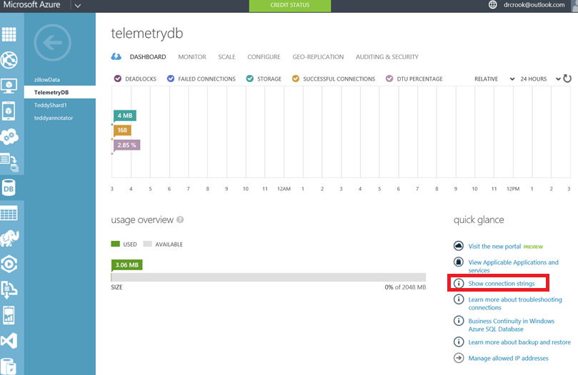
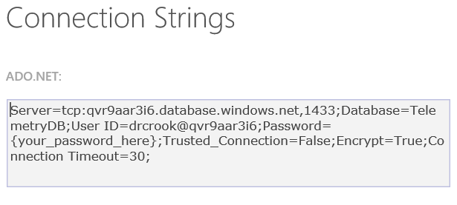
Get SQL Server Connection String

Slide 26
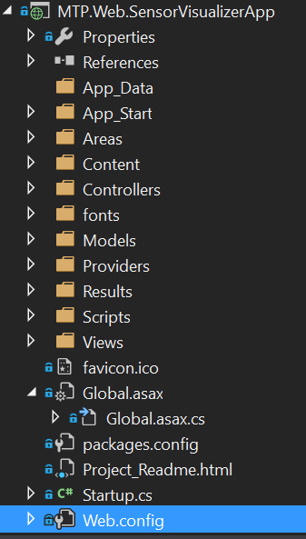
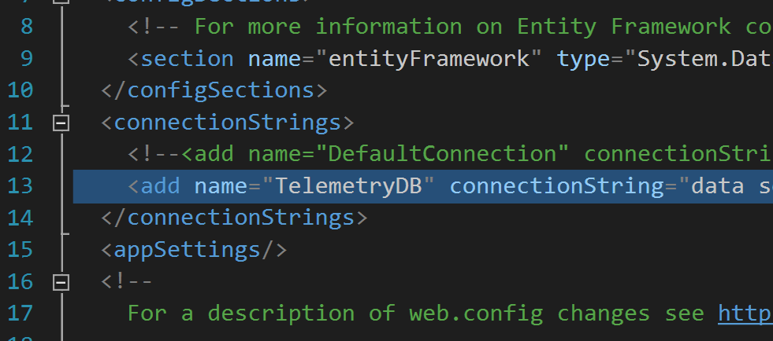
Configurations – Website Config
Replace with your connection string
Name must be “TelemetryDB”
Notes:
Add the SQL Connection String here. Remember to include your password. This name is being looked for by Entity Framework.

Slide 27
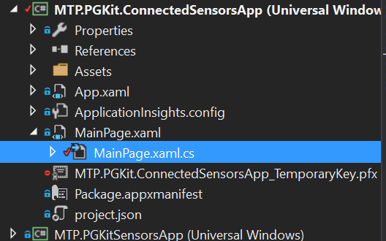
Configurations - Device Config
Your Location
Your DeviceId
Your IoTHub Conn String
Notes:
Use the IoT Hub Connection String specific to your device acquired from the Device Explorer tool.

Slide 28
Get Device Connection String
Click on Device
Get Context
Select Copy Connection String

Slide 29
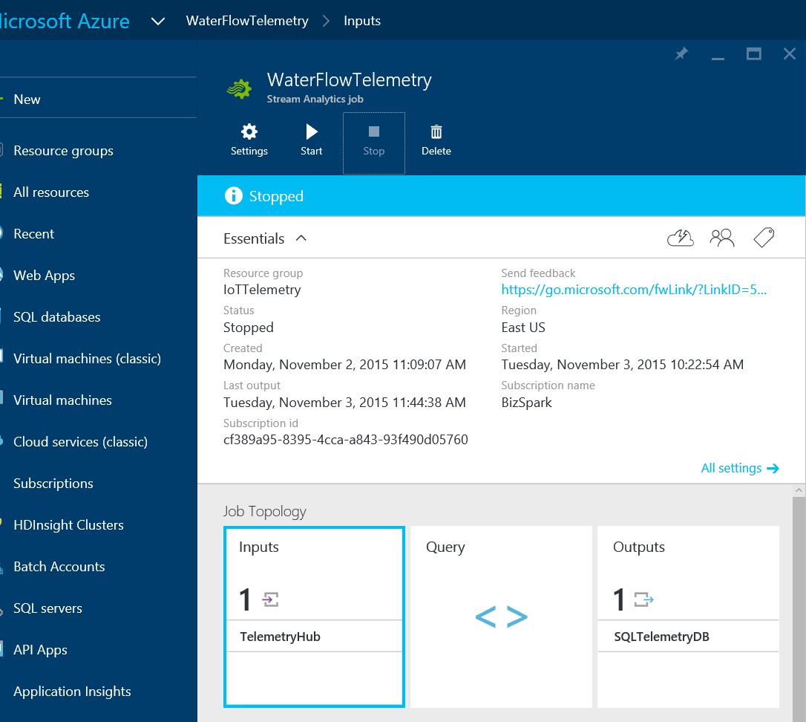
Stream Analytics Configuration
Notes:
Show from new portal getting to Stream Analytics.
Select Inputs.

Slide 30
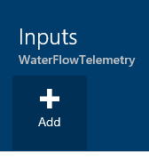
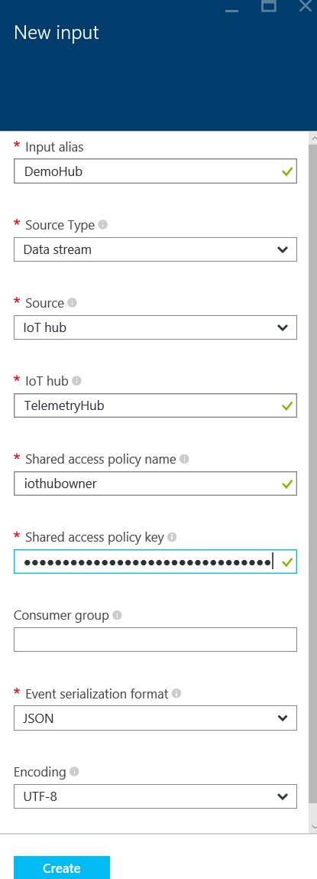
Stream Analytics - Input
Notes:
Select Add, and fill in the required data.
Show where to get data from. Helpful to have two new portals open at the same time.

Slide 31
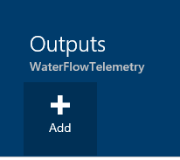
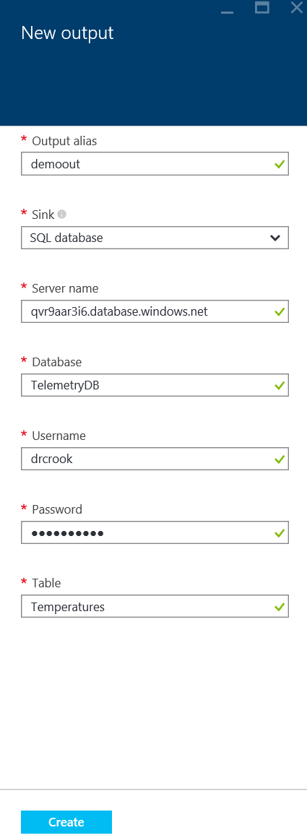
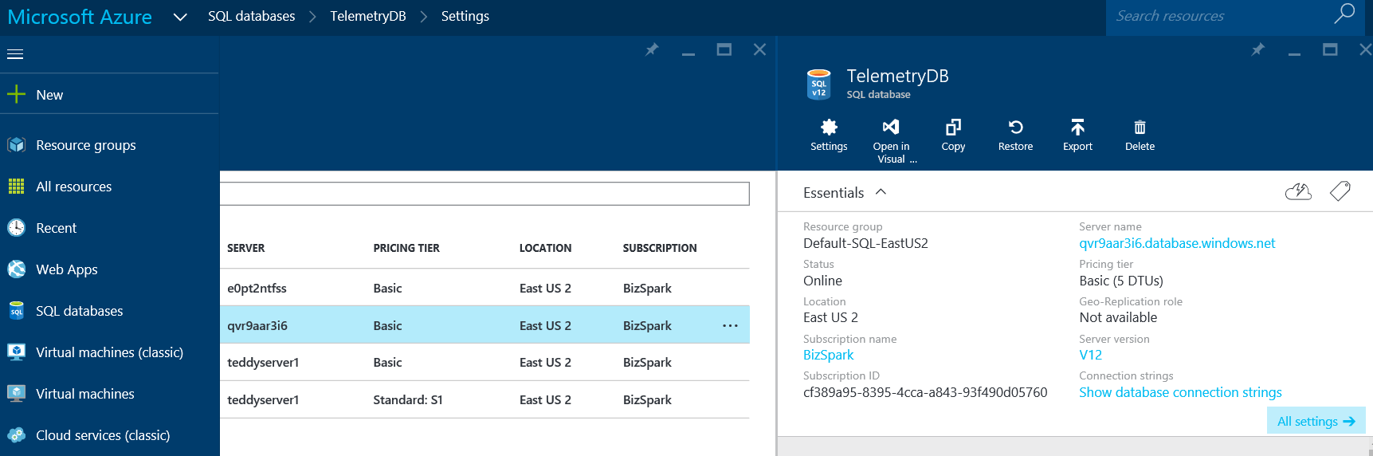
Stream Analytics - Output

Slide 32
Stream Analytics - Query
SELECT
Location, Temperature, CollectionTime, DeviceId
FROM
TelemetryHub
Notes:
Notice that “INTO” is not defined. As it currently stands, adding an into statement and using the output alias causes an error in which the data is not successfully dumped into the output store. Set only a single output and drop the into statement.
The from statement is the alias name for the input defined earlier.

Slide 33
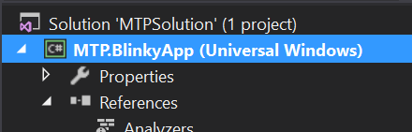
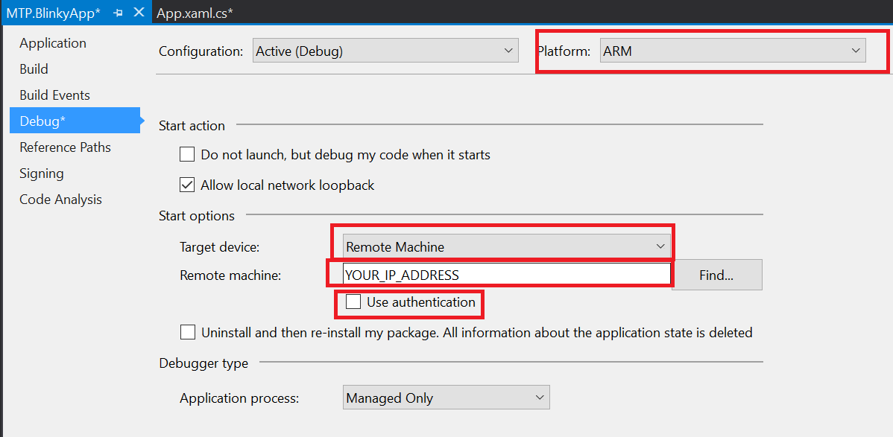
Set Build for your Device
Right Click Project
Properties (at the bottom)
ARM
Remote
Your IP
No Auth

Slide 34
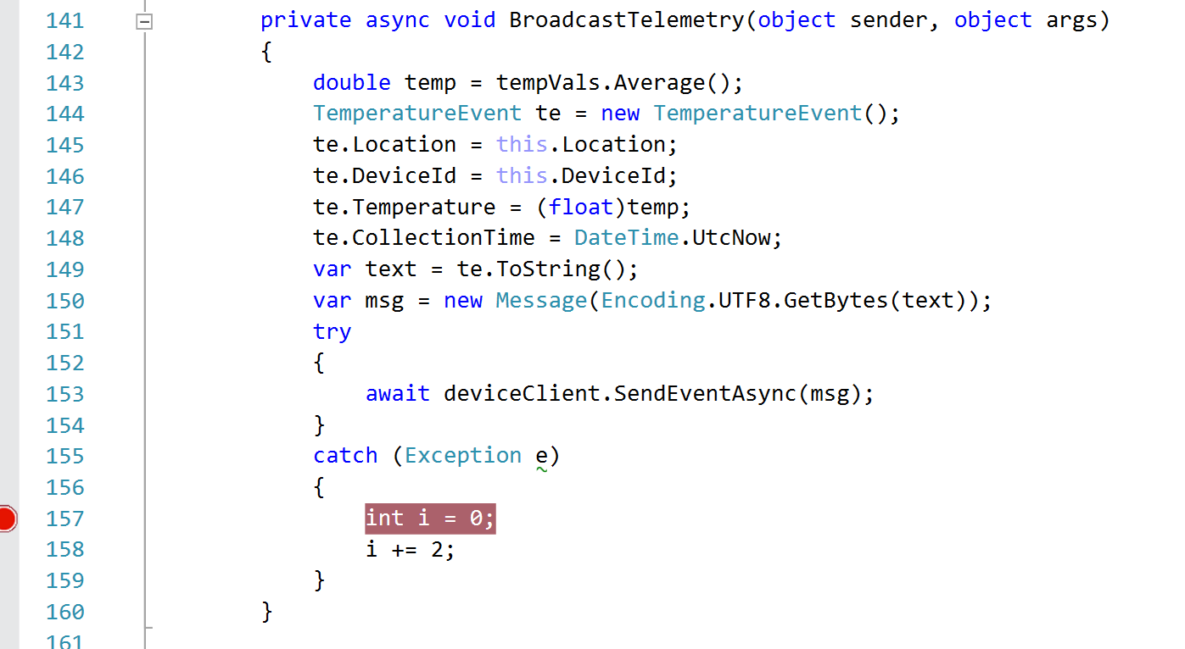
Change Code
If not using sensors w/MCP3008
Notes:
Code changes in several places.
BroadcastTelemetry
Delete Analog Reading Code

Slide 35
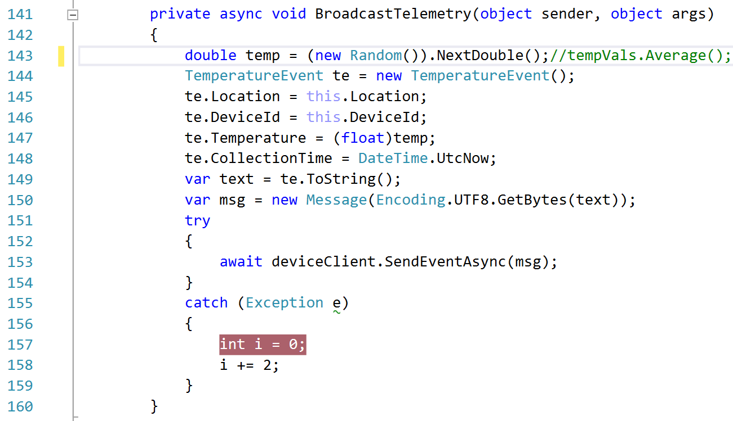

Slide 36
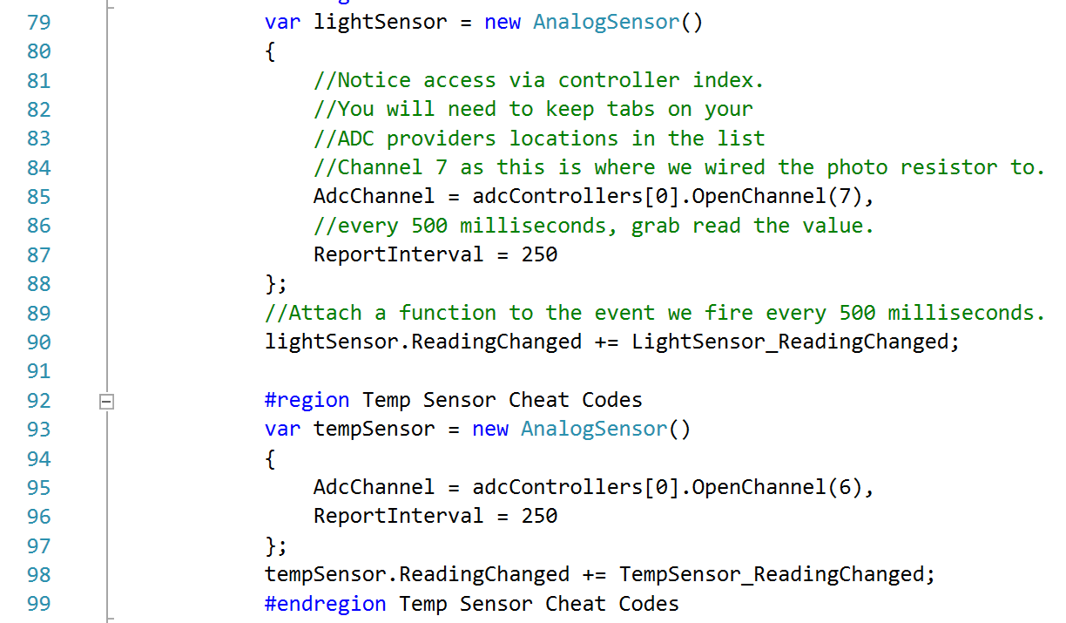

Slide 37
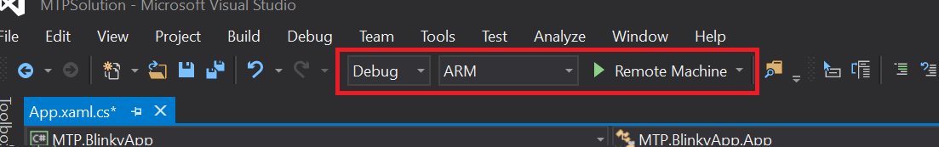
Deploy && Debug
Set to ARM
Click In Gray Area
Creates red breakpoint
Click Green Arrow
You can remove breakpoint and click green arrow to continue.

Slide 38
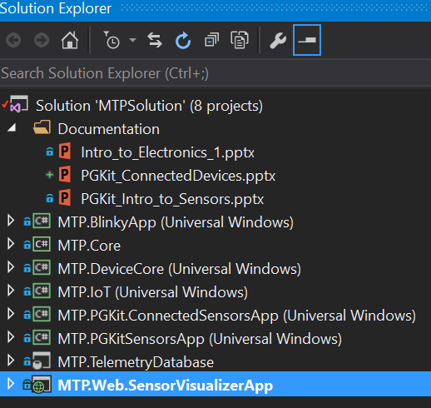
Debug Visualization Website
Open a second VS 2015
Right Click -> Debug

Slide 39
Code Walk Through

Slide 40
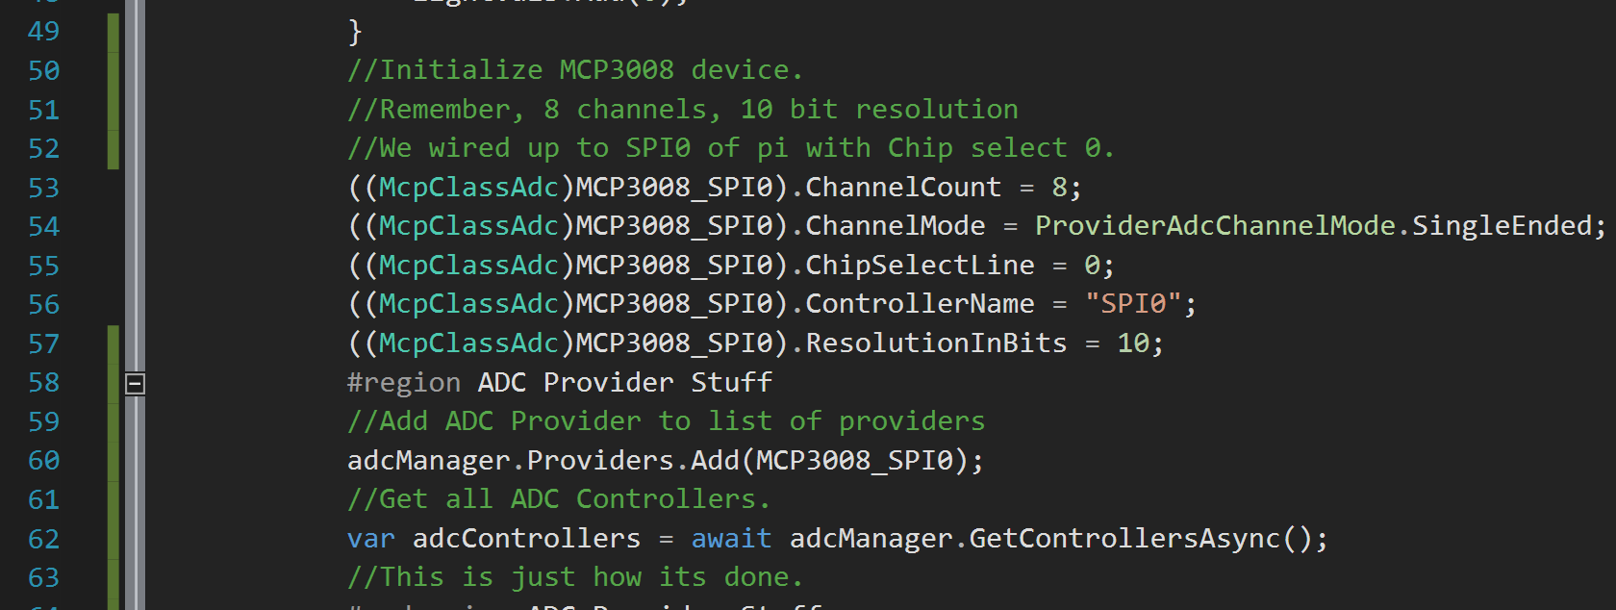
Code Walk Through
Notice extensive comments ☺
Notes:
Walk through the Event Hub pushing.

Slide 41
There is more!

Slide 42

Brown Bag Series
Electronics 101
3 Rotating Sessions
IoT 101
3 Rotating Sessions
Machine Learning 101
2 Rotating Sessions
3D Printing 101
Just 1 session!

Slide 43
Questions?

Slide 44
dacrook@Microsoft.com
(980)228-6278
@Data4Bots
www.indiedevspot.com

